Slide 1
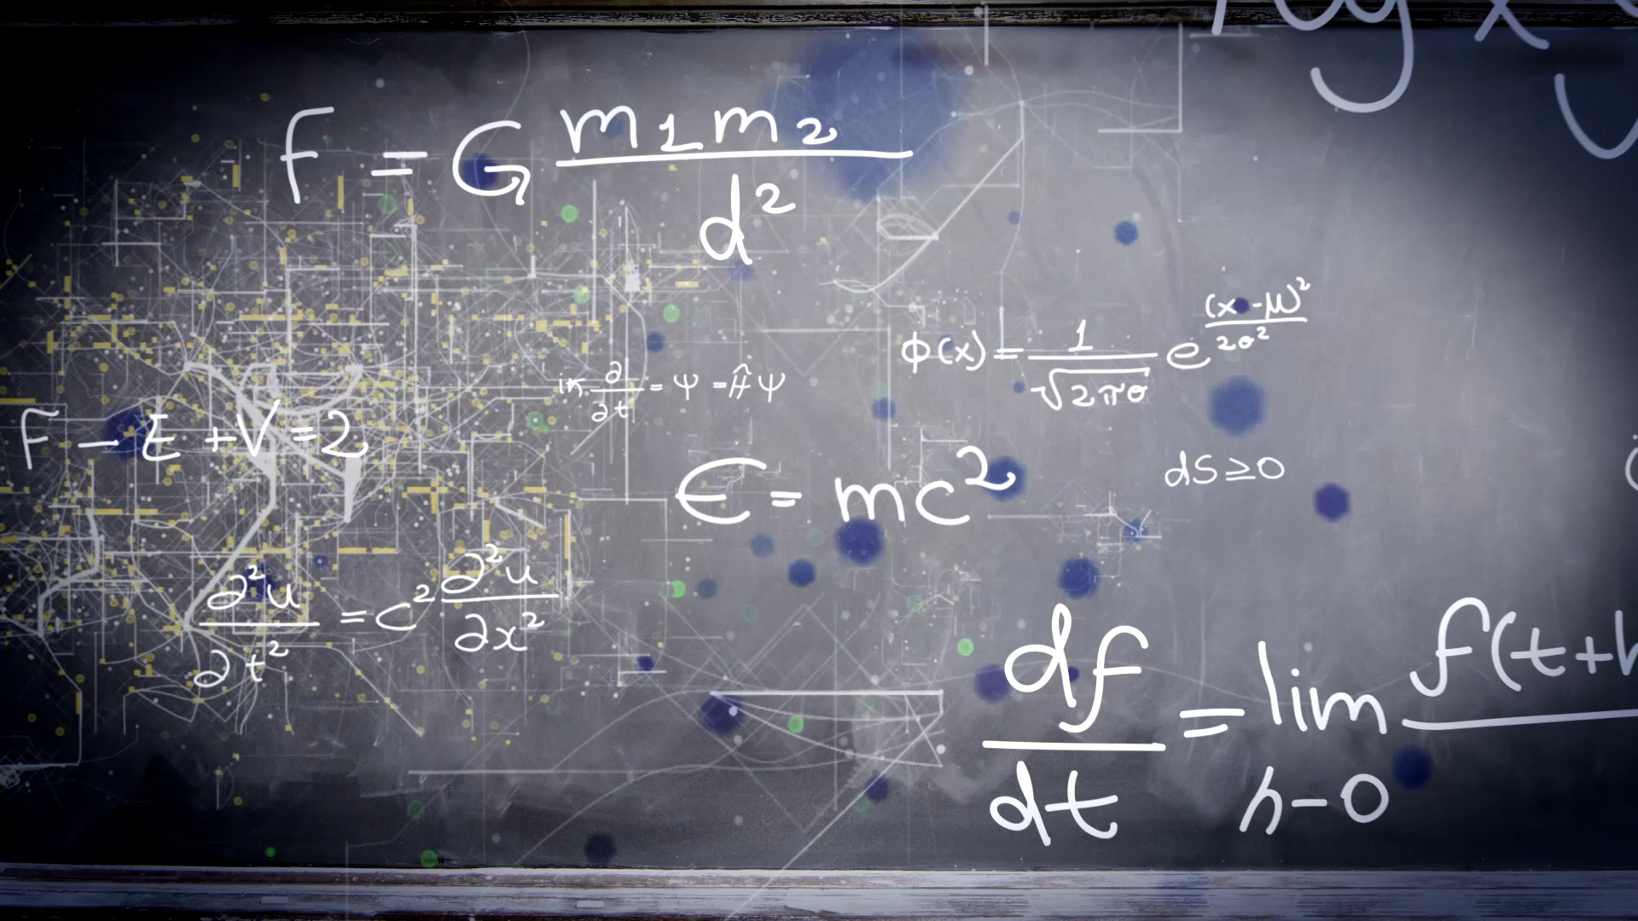
Enhanced Quantum Dynamics
Open the Quantum BlackBox

Slide 2
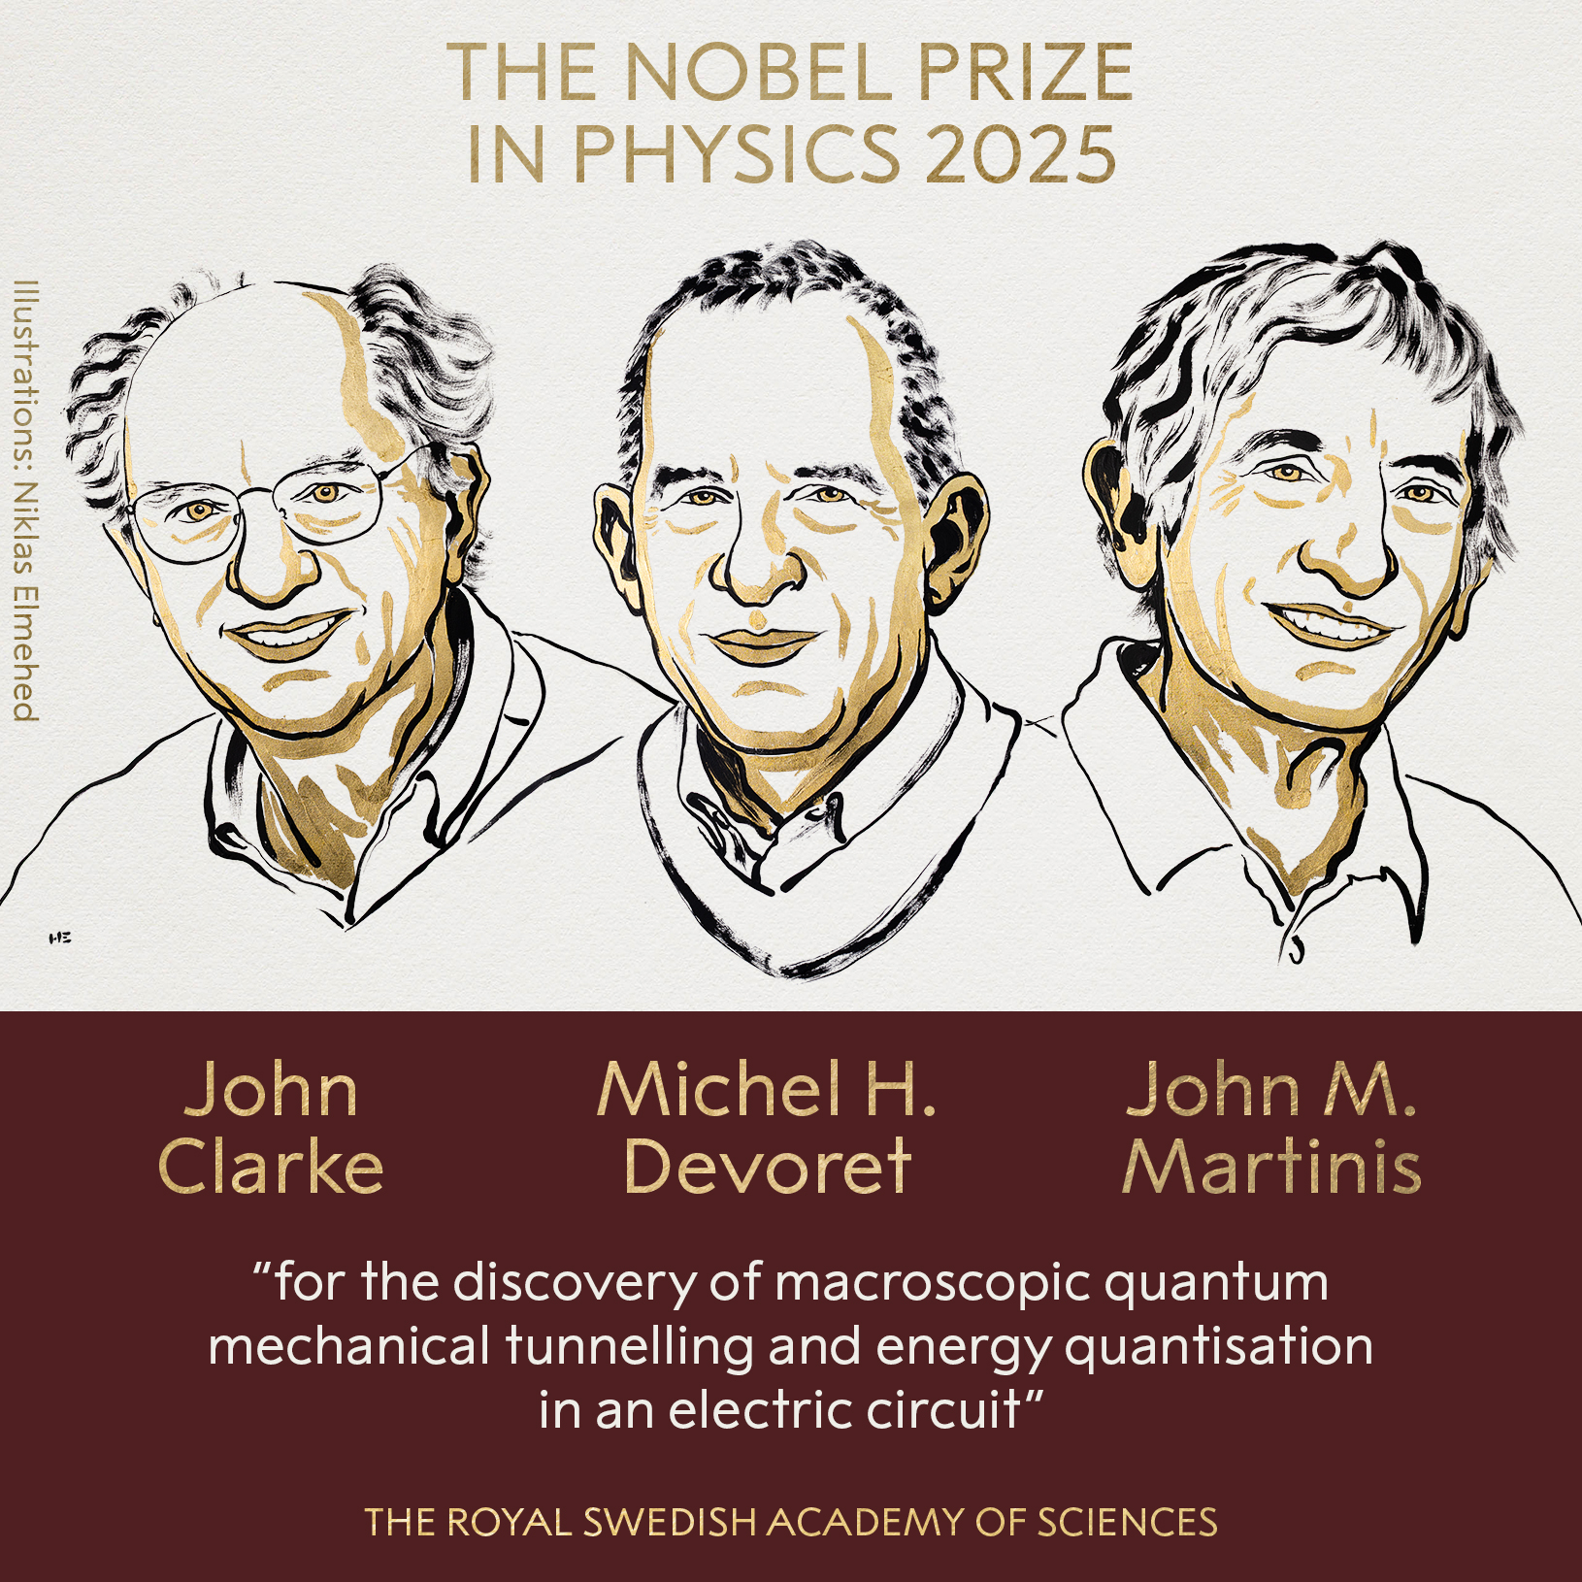

~100 Qbits

Slide 3
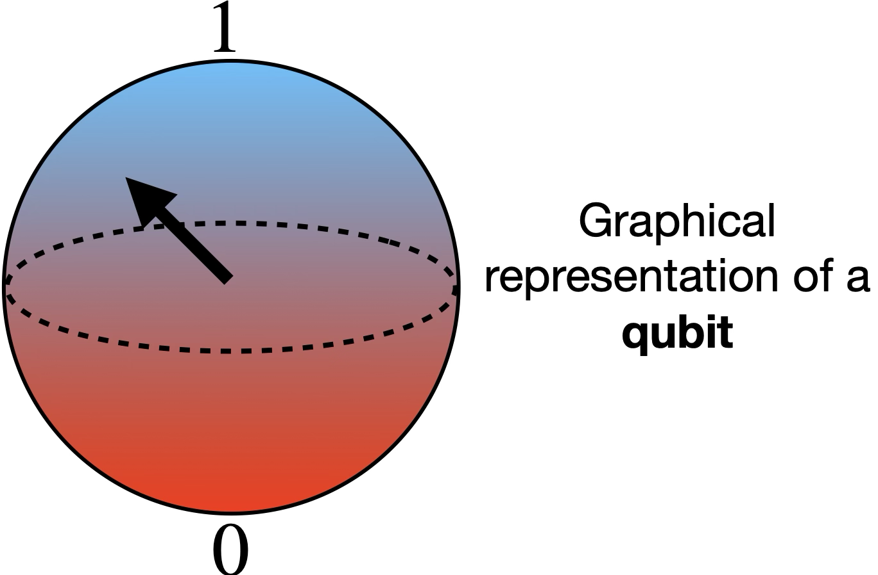
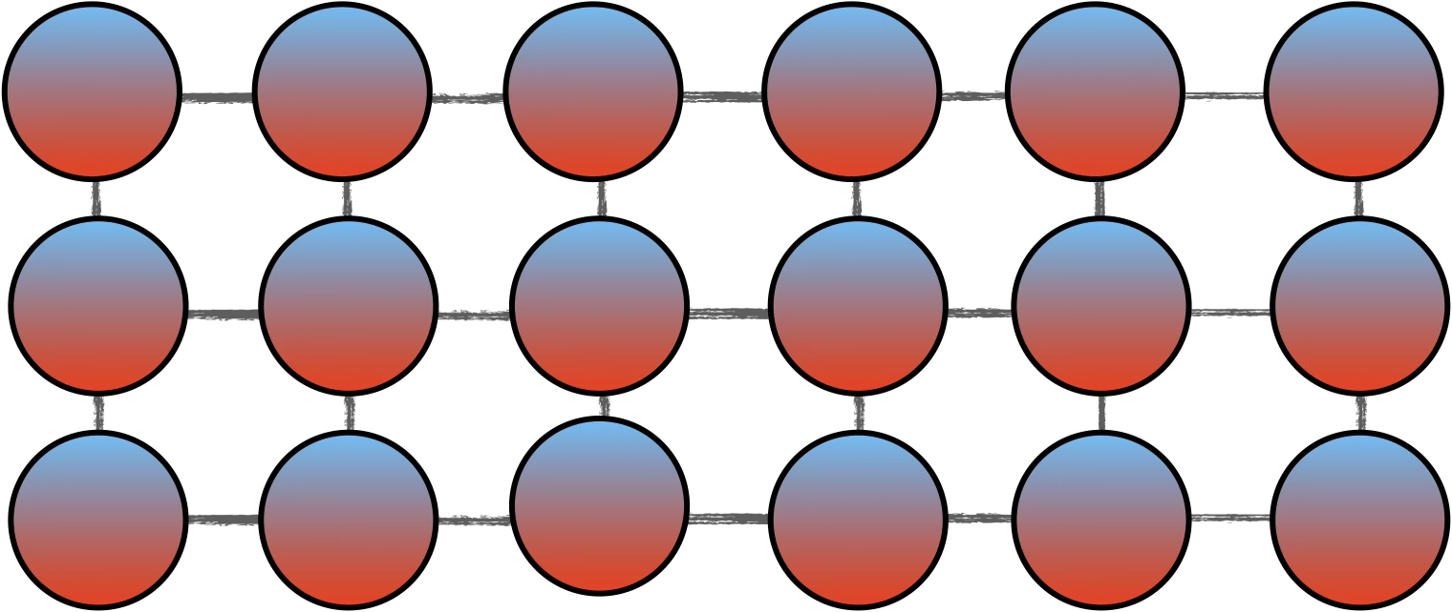
Quantum mechanics describes the behavior of matter at microscopic level: atoms, molecules, materials, radiation, fundamental particles etc.
Systems composed of many interacting qubits are characterized by peculiar phenomena, such as entanglement.
Quantum Chip
Qbits interacts in a non-classical way - Entanglement
Problem: Complexity scales exponentially with the number of Qbits
if #qbits > threshold → We cannot understand what happens (the chip becomes a Black Box) and we cannot predict the behavior!

Slide 4
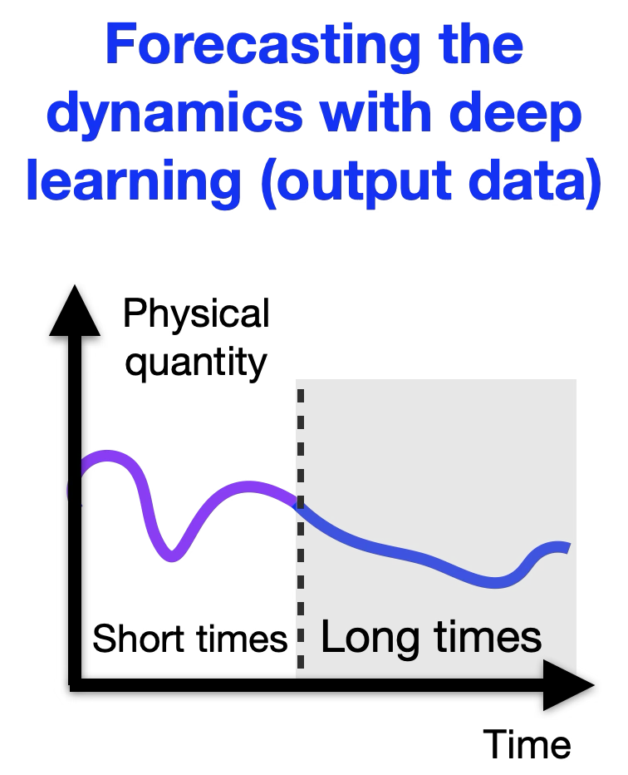
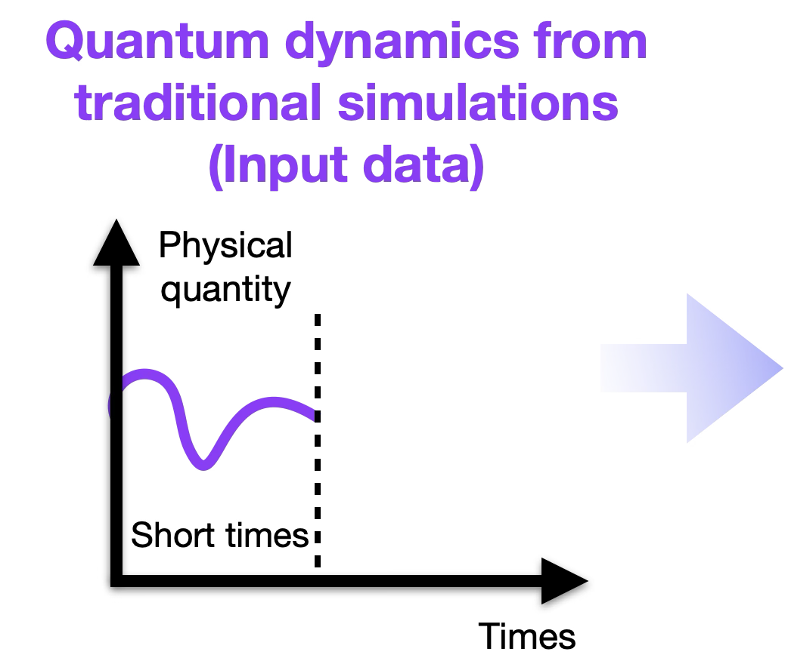
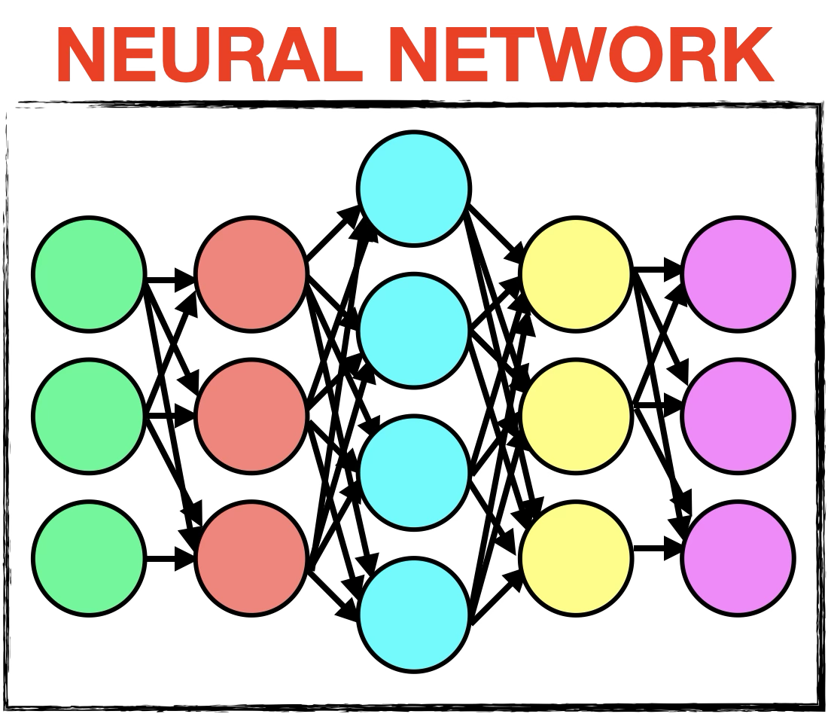

IDEA: Let a Neural Network predict the dynamics to allow for Chips with a greater number of Qbits

Slide 5
Challenges:
Find the shorter time window which yields to the best predictions!
Enable Super Resolution!
Explain Predictions using attention maps!

